Slide 1
EBED-01 Project DEAF

Slide 2
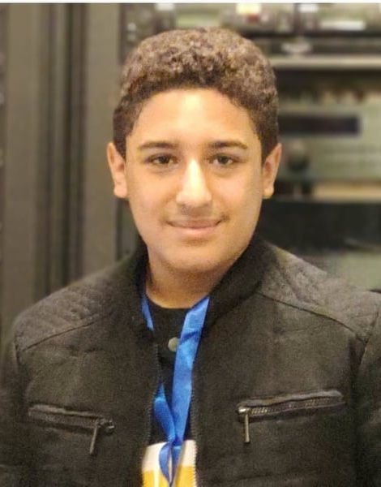
Youssef Mohamed STEM 6th of October for boys
1ST Team Member
Has great experience in:
App developing
Deep Learning
Embedded systems

Slide 3
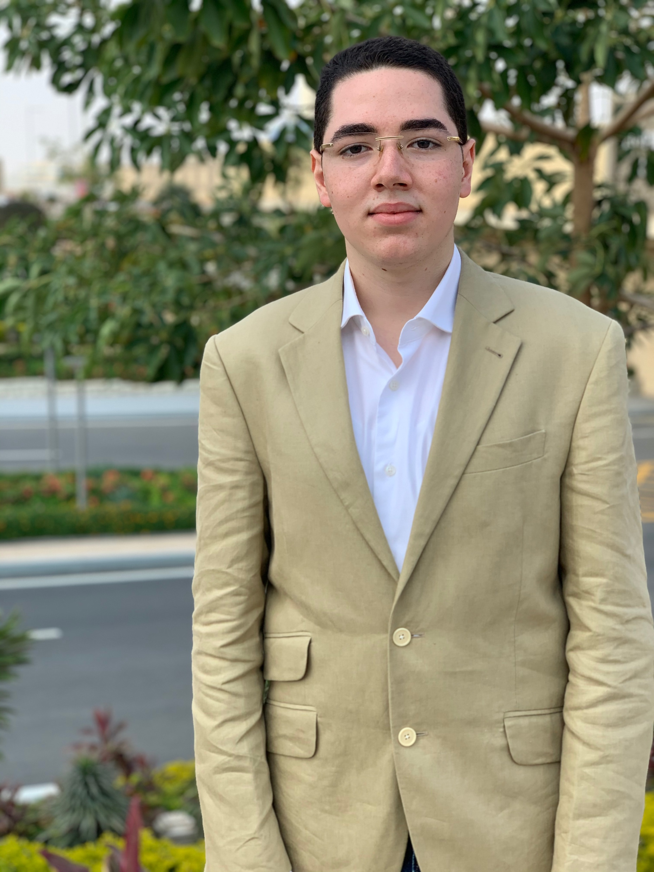
Marawan Salah El-Orman official languages school
2nd Team Member
Has great experience in:
Embedded systems
Robotics
Data analysis

Slide 4
The problem

Slide 5
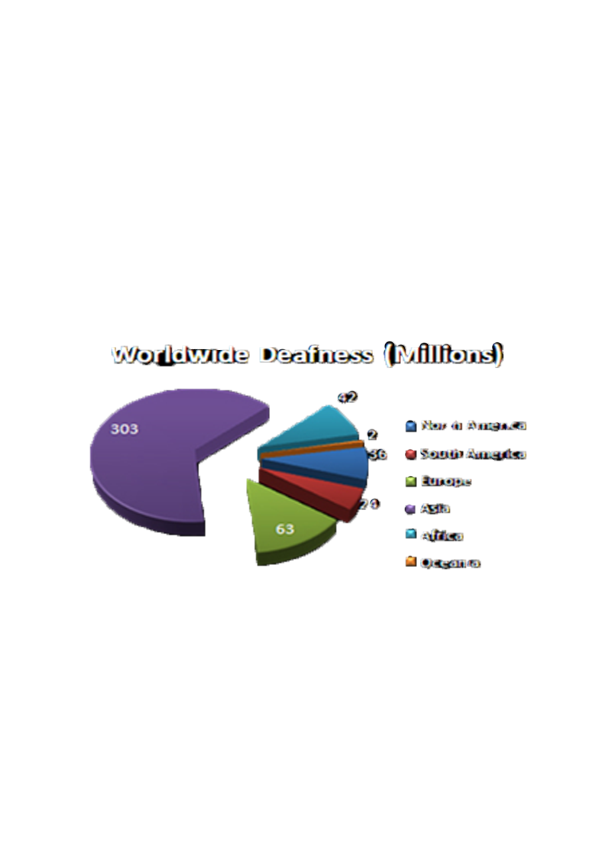
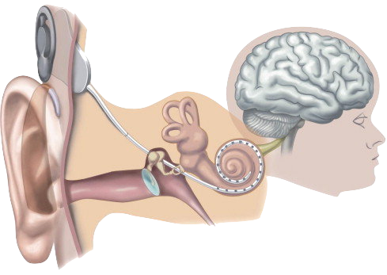
There are lots of deaf people around the world
nearly 470 million human being is suffering right now from deafness, an astonishing 6% of all the world population.
The struggling of developing nations in providing minimum health care requirements.
A diverse amount medical solutions have been developed that are too expensive and won’t be affordable to lots of people.

Slide 6
Our Goal

Slide 7
Provide the deaf with:
A better and affordable solution to communicate easily in the society.
more immersive feeling while listening to music or their surroundings.

Slide 8
Our Solution

Slide 9
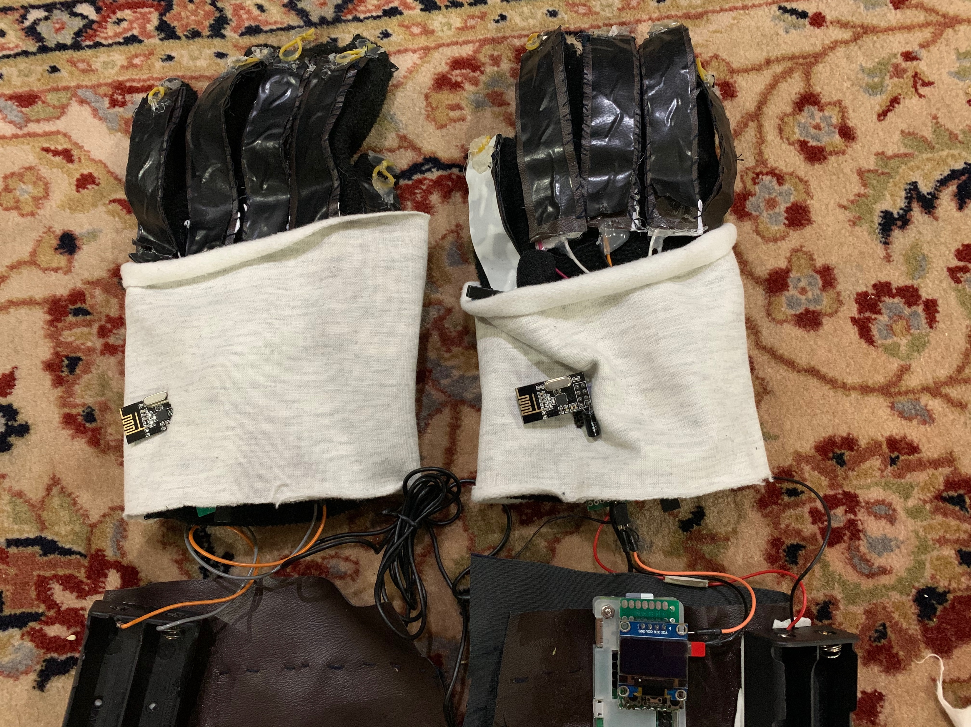
1. Two Gloves
It uses a variety of movement and elevation sensors. Thus, making it capable of translating it via a pre-written instruction into hearable audio, so they can express them self’s and feel more connected to the world. Adding to this that most of his day-to-day life scenarios, we embedded a microphone and a small OLED screen to write the other talker words.

Slide 10
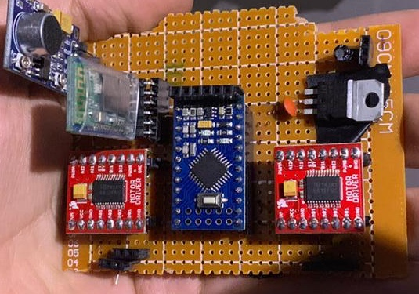
2. the band of vibration
we can obtain sound waves from the surrounding and process them by sound sensor and an algorithm that can help in identifying the frequency per tone. With this analyzed frequency spectrum in hands, it can divert it into vibrations via specialized motors. All of this lead by the help of deaf people high somatosensorial abilities, can be used in order to determine every sort of audible art a deaf person can wish to hear.

Slide 11
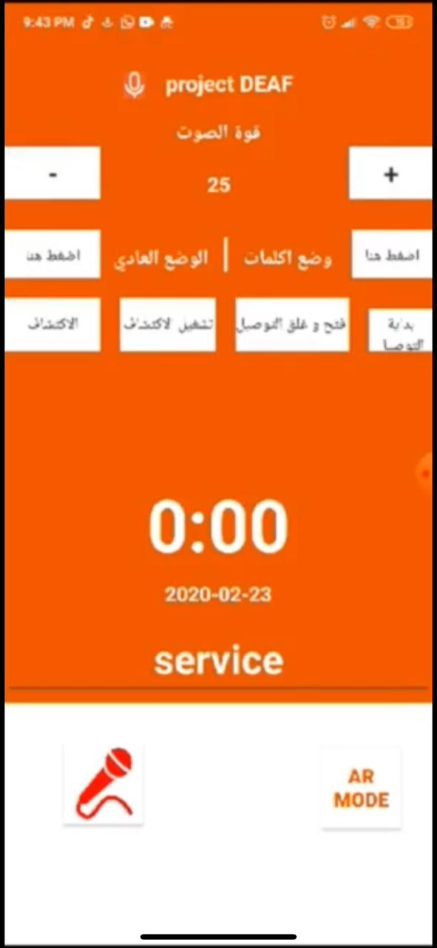
This App have lots of features for example :
it can communicate with the band of vibrations device to control the intensity of the motors.
it has speech to text and AR mode to make it easier for deaf who can’t read.
3.MOBILE Application

Slide 12
Materials

Slide 13
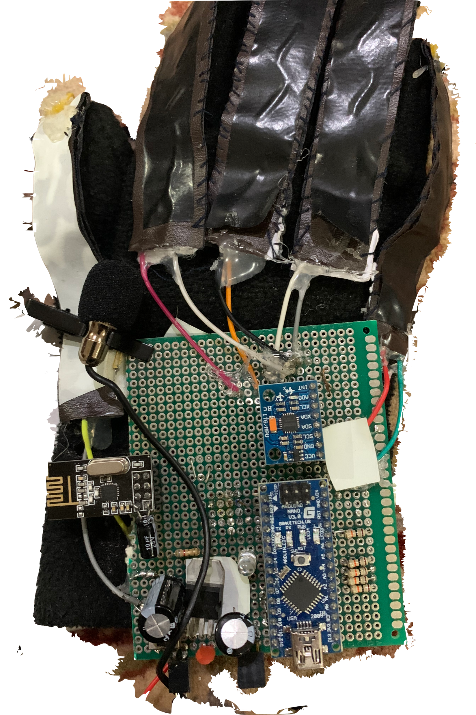
1. Two gloves(main components)
Microphone
Materials | Quantity | price
Arduino nano | 2 | 170
Gloves | 2 | 50
MPU650 | 2 | 160
NRF 24|01 | 2 | 60
0.5W SPEAKER | 1 | 20
Raspberry pie zero | 1 | 500
MP3 MODULE | 1 | 100
O-LED display | 1 | 70
USB microphone | 1 | 50
Li-ion battery(3.7v) | 4 | 100
Velostat strip
MPU- 6050
Arduino Nano
NRF

Slide 14
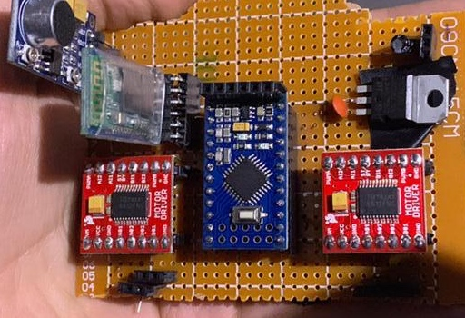
1. The band of vibrations(main components)
Sound
Sensor
Arduino pro mini
Materials | Quantity | price
Arduino pro mini | 1 | 70
Motor driver TB6612FNG | 2 | 50
Sound sensor | 1 | 160
Vibrator motor | 4 | 60
Li-ion battery(3.7v) | 2 | 50
Motors
Motor drivers

Slide 15
Methods

Slide 16
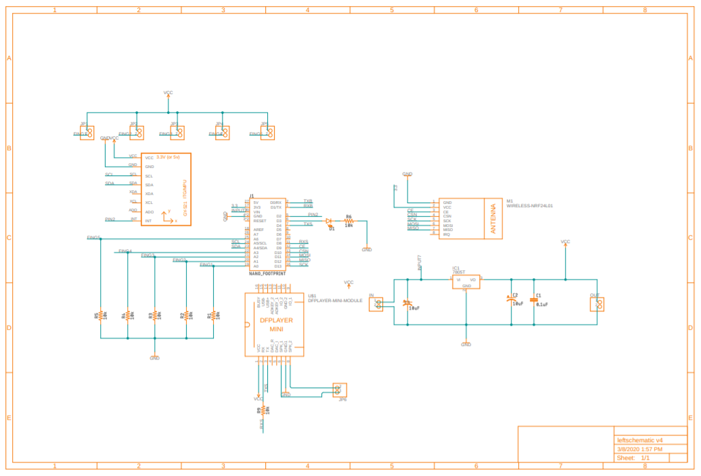
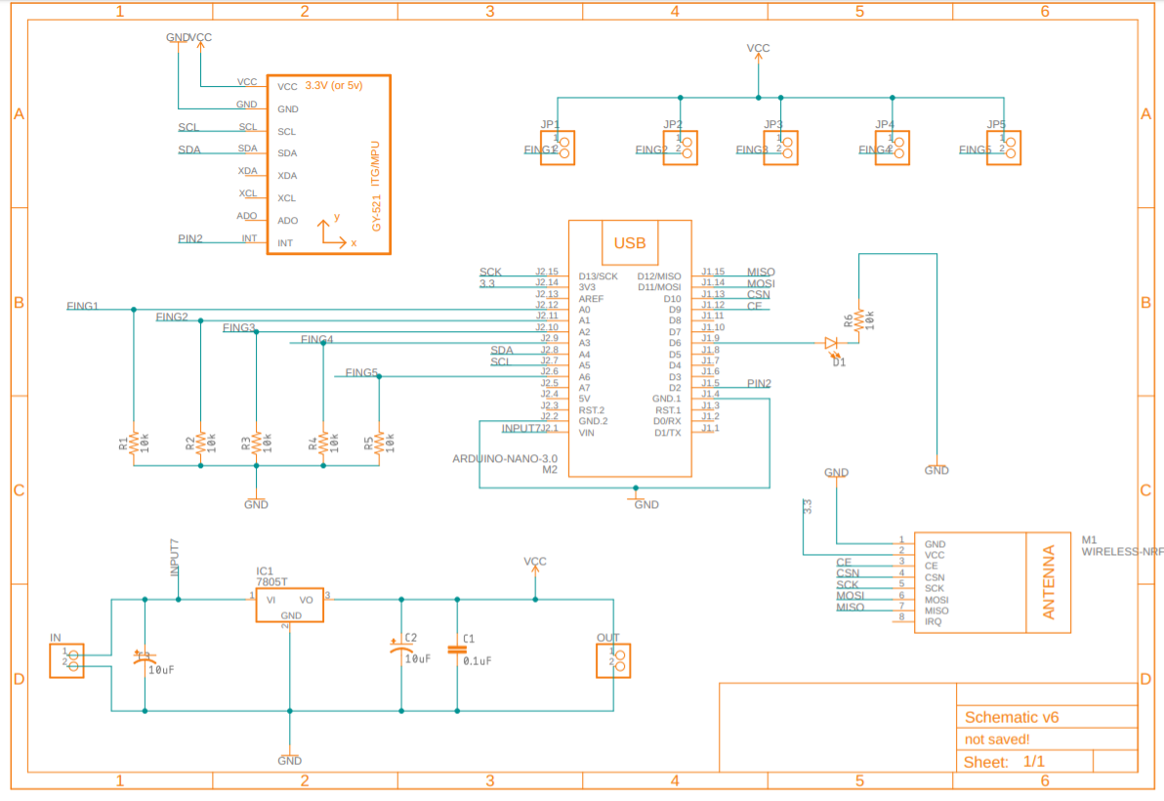
Gloves
The band of vibrations
Arduino nano is connected with :
Mpu6050
Mp3 module(left hand only)
Speaker and velostat
NRF wireless reciever
Raspberry pi is connected with (mic and OLED display)
Arduino pro mini is connected with:
Sound sensor
Motors and motor drivers
Bluetooth module.
The left glove
The right glove

Slide 17
Analysis

Slide 18
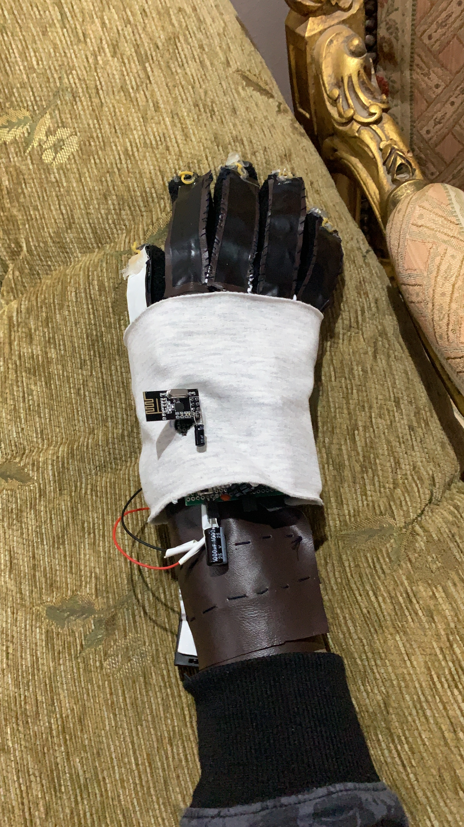
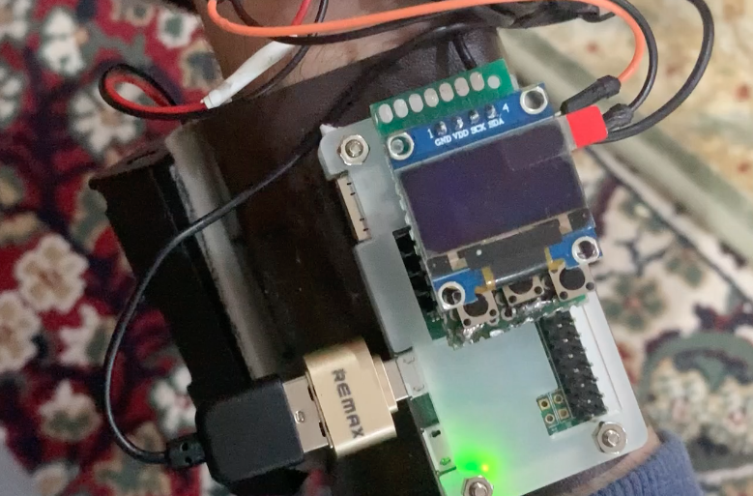
How the gloves work?!
The Arduino
it collect the data from all sensors connected to it then recognize the movement of the hand. If it recognized a movement then It will send this word through speaker by mp3 module.
Raspberry pi
it collect the data microphone on the board then uses sphinx and google speech-to-text to recognize words and show it on the OLED display on the glove.

Slide 19
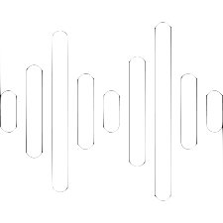
How the band of vibrations works?
It collects the data from sound sensor then apply FFT algorithm to change the sound inputs with different frequencies to outputs in form of vibrations through 4 different specialized vibration motors with various intensity.

Slide 20

How the app works?
Speech to text recognition
It connects to google online deep STT algorithms and through the usage of any smartphone microphone, it can process the words and sentences in Arabic and then return back the final results to the user interface for deaf people to interrupt the said sentences.

Slide 21
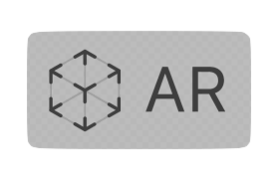
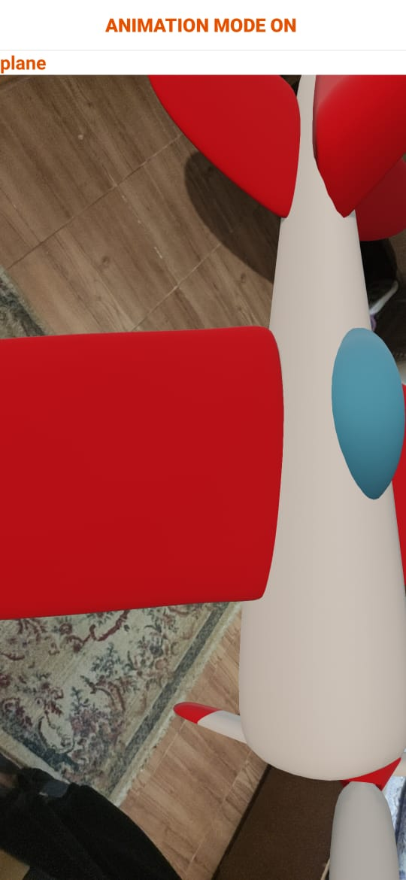
How the app works?
AR illustrations
Using state of the art, google AR core capabilities, we can receive the coordinates of the current smartphone position relative to its surroundings and map the area around the cameras, then by the usage of stored 3D animated assists and the previous mentioned Google STT algorithm, the app identifies the text said by the user and then terns it into an augmented reality illustrations so that illiterate deaf users who can't read the text displayed by the first part of the application can clearly understand.

Slide 22
Our tests

Slide 23
How we tested it?
1st Test
2nd Test
3rd Test
Using special common words in Arabic like greetings and requests, the hard hearing people will be exposed to it 4 times each, then measure how many words they will be able to identify from 10 words
A different type of test was conducted to test google text-to-speech recognition skills in native Arabic using the raspberry pi device. 2 different people with varied accent will say a series of 25 sentence, and the number of the correct sentence identified from 25 will be counted.
A series of tests was conducted to test the gloves prototype ability to identify motion to sounds using special pre-programmed commands Into the code itself.

Slide 24
Results

Slide 25
1st Test results
Vibrations prototype | Near deaf people | Normal people
2 vibration samples trail 1 | 5 sentences | 2 sentences
2 vibration samples trail 2 | 4 sentences | 3 sentences
4 vibration samples trail 1 | 7 sentences | 5 sentences
4 vibration samples trail 2 | 8 sentences | 4 sentences
6 vibration samples trail 1 | 10 sentences | 6 sentences
6 vibration samples trail 2 | 8 sentences | 4 sentences

Slide 26
2nd Test result
Mobile app | 1st person | 2nd person
Trail 1 | 24 words | 25 words
Trail 2 | 24 words | 23 words

Slide 27
3rd Test result
Glove trails | 1st person | 2nd person
Trail 1 | 8 words out of 9 | 7 words out of 9
Trail 2 | 9 words out of 9 | 8 words out of 8

Slide 28
Recommendations

Slide 29
Recommendations for the future
2. Using a higher performance microcontroller
3. Making it more portable and practical to carry around
1. Using machine learning sound detection system and movement identification
4. Integrating cloud database storage for the APP

Slide 30
Conclusions

Slide 31
Our conclusions
our prototypes after lots of evaluation and ground testing have proven out that its capable of delivering most of its expectations as much as it could.
It excels in terms of cost effectiveness and practicality with a huge margin. Taking all of this into the consideration, it easily can satisfy most of the deafness and hard-hearing problems in the whole world.
Such a breakthrough with modern available technology can even lead to a dramatic increase in the workforce numbers and the overall population participation in building the community, killing the unemployment of millions of people on its way.

Slide 32
Acknowledgment

Slide 33
At the End
we would like to thank first and foremost Allah. then second to:
Mr. Sowilam Mehani (Project supervisor) for his outstanding efforts.
Ms. Mohammed Saeed (ISEF Organizer)
all Salah Elden school for disabled students staff (where we did our prototype testing on real world subjects)
Mrs. Shaimaa Saeed (Teacher at that school)
Special gratitude towards Professor Donovan Tokuyama at Stanford University

Slide 34
Thanks for your attention

